Slide 1
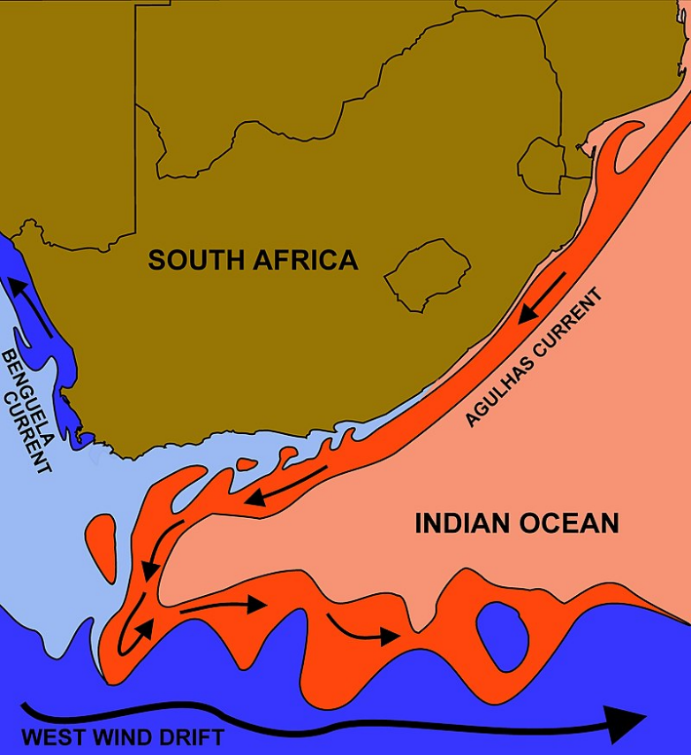
QGIS Exercise: Analysis of the 2019-2020 Marine Heat Wave in the Agulhas Current region
#MarineData4Africa
The courses of the warm Agulhas current (red) along the east coast of South Africa, and the cold Benguela current (blue) along the west coast. Credit: wikipedia.org.

